Slide 1
Html & Html-5
Hyper Text Mark Up Language

Slide 2
HTML stands for Hypertext Markup Language .
Html is used to make UI pages to develop web pages.
A Markup Language is a way that computers speak to each other to control how text is processed and presented.
To do this HTML uses two things: tags and attributes.

Slide 3
HTML stands for Hyper Text Mark-up Language, one of the document formats of the World Wide Web .
HTML files that generate Web pages are just text documents with .html or .htm file extensions .

Slide 4
Html History
HTML was originally developed by Tim Berners-Lee in 1990.
He is also known as the father of the web.
In 1996, the World Wide Web Consortium (W3C) became the authority to maintain the HTML specifications.
HTML also became an international standard (ISO) in 2000.
HTML5 is the latest version of HTML. HTML5 provides a faster and more robust approach to web development.

Slide 5
HTML 5 is the latest version of the HTML standard, and it offers many new features and improvements over previous versions. It’s designed to make website development faster and easier and provide a better user experience for people who visit your site.
One of the most notable features of HTML 5 is its support for audio and video playback. With HTML 5, you can embed audio and video files directly into your web pages without using third-party plugins like Flash or QuickTime.
HTML 5 also includes new elements that make it easier to create interactive web applications.
For example, the <canvas> element can be used to create games, data visualizations, and other types of interactive content. And the <svg> element allows you to embed vector graphics directly into your web pages.

Slide 6
For instance, HTML 5 offers better error handling and improved performance when parsing and rendering web pages. And the new version of the language is much more forgiving of errors, so it’s easier to create well-formed code that will work correctly in all browsers.
Overall, HTML 5 is a significant upgrade from previous versions of the HTML standard. It offers many new features and improvements that make website development faster and easier.

Slide 7
The key difference between HTML and HTML 5 is that HTML 5 is an updated version of the HTML language that offers many new features and improvements over previous versions.

Slide 8
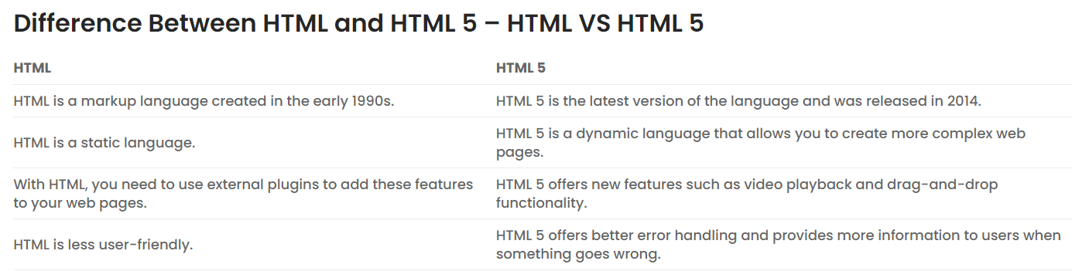

Slide 9
Benefits Of Using HTML5 Over HTML
1.Easy to use HTML
HTML5 is much easier to use than HTML. There are fewer tags and attributes to remember, and the syntax is more straightforward. This makes it quicker and easier to write code, saving time in the development process.
2. Better User Experience
Better User Experience
HTML5 offers a better user experience than HTML. The new features make it possible to create more interactive and responsive websites. This results in a more enjoyable experience for people who visit your site.
3. More Powerful
Powerful
HTML5 is more powerful than HTML. The new features allow you to do more with your website, including adding multimedia content and creating sophisticated effects. This makes your site more engaging and impressive.

Slide 10
4. Faster Development
faster development
HTML5 enables faster development than HTML. The simplified syntax and new features make it possible to build websites quicker. This saves time and money in the development process.
5. Future-Proof
future-proof
HTML5 is the future of web development. The new features are designed to make website development more efficient and effective. This means that your site will be able to take advantage of the latest advances in technology as they become available.

Slide 11
Why HTML 5 Is Better Than HTML?
HTML 5 offers some features that HTML doesn’t have. Some of these features are:
1. Improved semantics: HTML 5 has new elements, attributes, and APIs that give developers more control over how content is presented and interacted with. This makes it easier to create meaningful and accessible web pages.
2. Offline storage: HTML 5 can store data locally on the user’s device, so websites can work even if the user is offline. This is especially useful for mobile devices, where network connectivity can be unreliable.
3. Better performance: HTML 5 includes features that make websites load faster and run more smoothly. For example, the new ‘async’ attribute on script tags allows scripts to load in the background without blocking the page rendering.
4. New elements: Some of the new elements in HTML 5 include ‘article’, ‘header’, and ‘canvas’. These elements provide more semantics and structure to web pages, making them easier to read and understand.
5. New attributes: HTML 5 has new attributes that give developers more control over presenting content. For example, the ‘contenteditable’ attribute can be used to make any element editable by the user.

Slide 12
6. Improved forms: HTML 5 includes many new features that improve the way forms work. For example, the ‘placeholder’ attribute can be used to hint what they should enter into a field to the user.
7. Designed to be more interoperable with other technologies: One of the goals of HTML 5 is to be more compatible with other technologies such as CSS and JavaScript. This makes it easier to create websites that work well across different browsers and devices.
8. New APIs: HTML 5 includes new APIs that give developers more control over how content is presented and interacted. For example, the ‘history’ API allows developers to manage the browser’s history to create a custom back/forward buttons or track the user’s progress through a page.
10. Deprecated features: Some features present in earlier versions of HTML have been deprecated in HTML 5. For example, the ‘target’ attribute on links is no longer supported. This means developers need to be aware of the changes to create websites that work well across all browsers and devices.

Slide 13
HTML5 is the newest specification for HTML, the language that web browsers read to display web pages. HTML5 has many new features intended to make creating websites easier and people's experience in using those websites better. Among those features are many enhancements to web forms.

Slide 14
HTML5 document with HTML5 doctype
<!DOCTYPE HTML>
<html lang="en">
<head>
<meta charset=utf-8>
<title>HTML5 doctype example</title>
</head>
<body>
<h1>Tutorial of HTML5 doctype</h1>
<p>HTML5 has loads of new exiciting features.</p>
</body>
</html>

Slide 15
Definition and Usage
All HTML documents must start with a <!DOCTYPE> declaration.
The declaration is not an HTML tag. It is an "information" to the browser about what document type to expect.
In HTML 5, the declaration is simple:
<!DOCTYPE html>

Slide 16
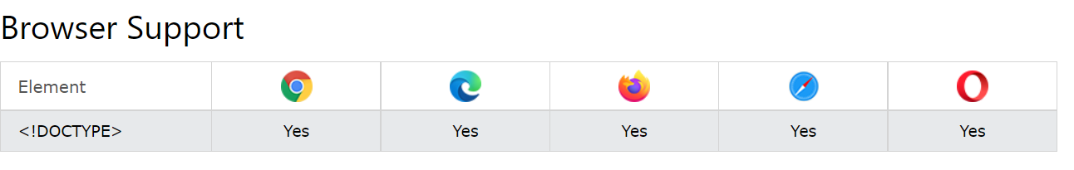

Slide 17
Older HTML Documents
In older documents (HTML 4 or XHTML), the declaration is more complicated because the declaration must refer to a DTD (Document Type Definition).
HTML 4.01:
<!DOCTYPE HTML PUBLIC "-//W3C//DTD HTML 4.01 Transitional//EN" "http://www.w3.org/TR/html4/loose.dtd">
XHTML 1.1:
<!DOCTYPE html PUBLIC "-//W3C//DTD XHTML 1.1//EN" "http://www.w3.org/TR/xhtml11/DTD/xhtml11.dtd">

Slide 18
The <!DOCTYPE> declaration is NOT case sensitive.
Examples
<!DOCTYPE html>
<!DocType html>
<!Doctype html>
<!doctype html>

Slide 19
Need of the Html
HTML is a markup language that defines the structure of your content. HTML consists of a series of elements, which you use to enclose, or wrap, different parts of the content to make it appear a certain way, or act a certain way. The enclosing tags can make a word or image hyperlink to somewhere else, can italicize words, can make the font bigger or smaller, and so on. For example, take the following line of content:

Slide 20
Anatomy of an HTML element
The main parts of our element are as follows:
The opening tag: This consists of the name of the element (in this case, p), wrapped in opening and closing angle brackets. This states where the element begins or starts to take effect — in this case where the paragraph begins.
The closing tag: This is the same as the opening tag, except that it includes a forward slash before the element name. This states where the element ends — in this case where the paragraph ends. Failing to add a closing tag is one of the standard beginner errors and can lead to strange results.
The content: This is the content of the element, which in this case, is just text.
The element: The opening tag, the closing tag, and the content together comprise the element.

Slide 21
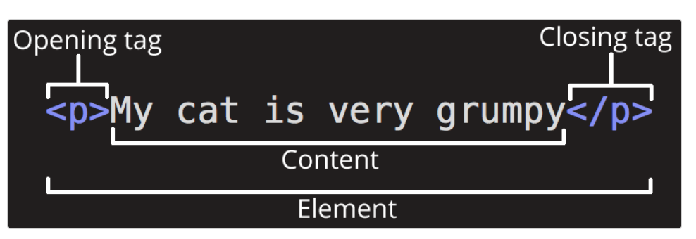

Slide 22
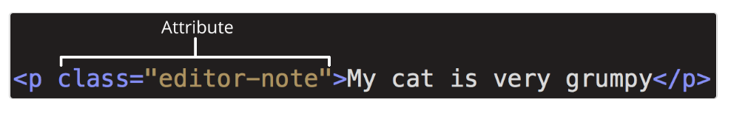
Elements can also have attributes that look like the following:

Slide 23
Attributes contain extra information about the element that you don't want to appear in the actual content. Here, class is the attribute name and editor-note is the attribute value. The class attribute allows you to give the element a non-unique identifier that can be used to target it (and any other elements with the same class value) with style information and other things.

Slide 24
An attribute should always have the following:
A space between it and the element name (or the previous attribute, if the element already has one or more attributes).
The attribute name followed by an equal sign.
The attribute value wrapped by opening and closing quotation marks.

Slide 25
'HTML5 Semantic Elements
If you know a little about HTML, you will know that HTML tags are (mostly) used to format content - these tags tell the browser how to display the content on the page. They give no indication as to what type of content they contain or what role that content plays in the page.
Semantic HTML5 addresses this shortcoming by defining specific tags to indicate clearly what role is played by the content those tags contain. That explicit information helps robots/crawlers like Google and Bing to better understand which content is important, which is a subsidiary, which is for navigation, and so on.

Slide 26
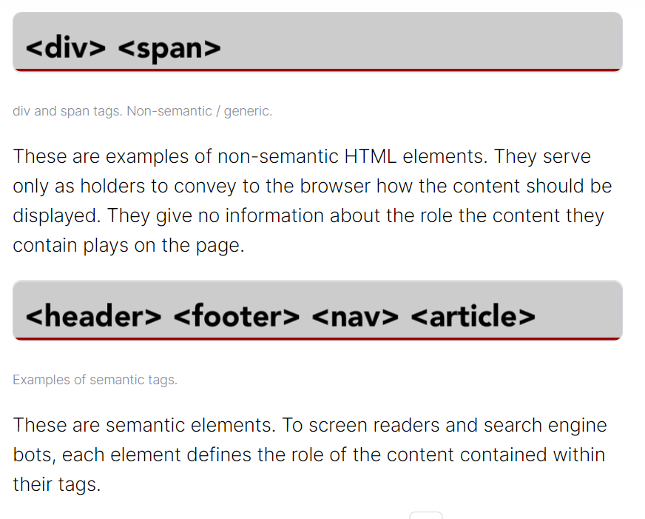

Slide 27
Semantic elements are one of the most significant introductions in HTML5. In the previous versions of HTML, the generic <div> tag with an id or class attribute was used for structuring a web page. For example, for defining sidebars, footers, menu or other structural blocks, the <div> tag was used with the corresponding meaning (div class="footer").
Semantic elements in HTML have intrinsic meaning and convey that meaning both to the browser and the developer. They clearly define what kind of content they contain (for example, the <footer> tag is used instead of <div id="footer">).

Slide 28
The <header> element
The <header> element defines a header for the document or section. It usually contains a logo, search bar, navigation links, etc.

Slide 29
<html>
<head>
<title>Title of the document</title>
</head>
<body>
<header>
<h1>Welcome to our page</h1>
<hr>
</header>
<article>
<header>
<h2>Title of the document</h2>
<p>The content of the paragraph.</p>
</header>
</article>
</body>
</html>

Slide 30
The <nav> element
The <nav> element defines a block of navigation links, either within the current document or to other documents. Note, that not all links in the HTML document can be placed inside the <nav> element; it can only include major navigation blocks. For example, the <nav> tag cannot be placed in the <footer> tag for defining links in the footer of the website.

Slide 31
<!DOCTYPE html>
<html>
<head>
<title>Title of the document</title>
</head>
<body>
<header>
<h1>Programming Courses</h1>
</header>
<nav>
<a href="/learn-html.html">HTML</a> | <a href="/learn-css.html">CSS</a> | <a href="/learn-javascript.html">JavaScript</a> | <a href="/learn-php.html">PHP</a> |
</nav>
<h2>Welcome to W3Docs!</h2>
</body>
</html>

Slide 32
The <article> element
The <article> element is used to specify an independent, self-contained content (articles, blog posts, comments, etc.). The content of the element has its meaning, and it is easily differentiated from the rest of the webpage content.

Slide 33
<!DOCTYPE html>
<html>
<head>
<title>Title of the document</title>
</head>
<body>
<article>
<h1>Title of the article</h1>
<p>Text of the article</p>
</article>
</body>
</html>

Slide 34
The <section> element
The <section> element is used to group standalone sections within a webpage containing logically connected content (news block, contact information etc.).

Slide 35
<!DOCTYPE html>
<html>
<head>
<title>Using the section tag</title>
</head>
<body>
<section>
<h1>Hypertext markup language HTML</h1>
<p>HTML is the standard markup language for creating web pages and web applications. Browsers receive HTML documents from a web server or from local storage and render the documents into multimedia web pages. HTML describes the structure of a web page semantically and originally included cues for the appearance of the document.</p>
</section>
<section>
<h1>CSS</h1>
<p>A formal language that is used as a description zone, formatting the appearance of a web page written with the help of markup languages HTML and XHTML but it can be applied to any XML-document, for example, to SVG or XUL.</p>
</section>
</body>
</html>

Slide 36
The <aside> element
The <aside> element defines a section with additional information related to the content around the <aside> element. It is generally used to enhance an article with additional information, or highlight the parts that can be interesting to the user.

Slide 37
<!DOCTYPE html>
<html>
<head>
<title>Title of the document</title>
</head>
<body>
<p>I like watching Game of Thrones.</p>
<aside>
<h4>Game of Thrones</h4>
<p>Game of Thrones is an American fantasy drama television series created by David Benioff and D. B. Weiss. It is an adaptation of A Song of Ice and Fire, George R. R. Martin's series of fantasy novels</p>
</aside>
</body>
</html>

Slide 38
The <footer> element
The <footer> element defines the footer of a web page or a section. As a rule, it contains copyright information, contact details, navigation links, etc.

Slide 39
<!DOCTYPE html>
<html>
<head>
<title>Title of the document</title>
<style>
.header {
height: 40px;
padding: 20px 20px 0;
background: #e1e1e1;
}
.main-content {
height: 60vh;
padding: 20px;
}
footer {
padding: 10px 20px;
background: #666;
color: white;
}
a {
color: #00aaff;
}
</style>

Slide 40
</head>
<body>
<div class="header">Header / Menu</div>
<div class="main-content">
<h1>Main content</h1>
<p>This is some paragraph. </p>
</div>
<footer>
<p>Company © W3docs. All rights reserved.</p>
</footer>
</body>
</html>

Slide 41
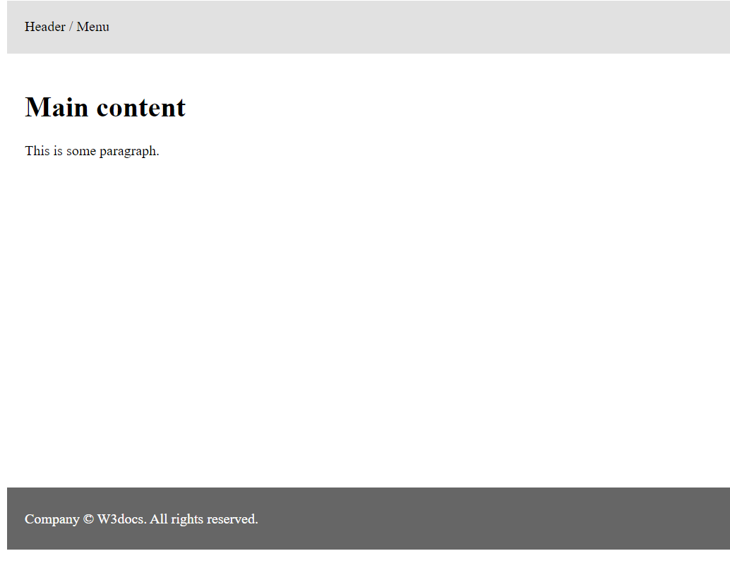

Slide 42
The <address> element
The <address> element is used to provide contact information of the author or the owner of an article, document or the website.

Slide 43
<!DOCTYPE html>
<html>
<head>
<title>Title of the document</title>
</head>
<body>
<address>
Author: W3docs Team<br />
<a href="programming.com">Send Mail to the Author</a>
</address>
</body>
</html>

Slide 44
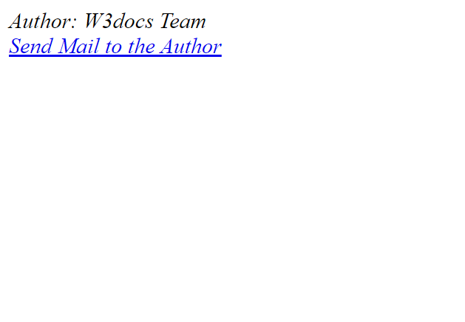

Slide 45
The <main> element
The <main> element defines the main content of the page. The content of the <main> tag must be unique and not duplicate blocks of the same type that are repeated in other documents, such as the header of a site, footer, menu, search, copyright information, etc.

Slide 46
<!DOCTYPE html>
<html>
<head>
<title>Main element</title>
</head>
<body>
<main>
<h1>Programming languages</h1>
<p>Languages HTML and CSS are intended for site layout.</p>
<article>
<h2>HTML</h2>
<p> HTML is a language of hypertext markup, which is used to create web pages. </p>
<p>... </p>
<p>... </p>
</article>
<article>
<h2>CSS</h2>
<p>CSS is a language of styles, defining the display of HTML documents. </p>
<p>... </p>
</article>
</main>
</body>
</html>

Slide 47
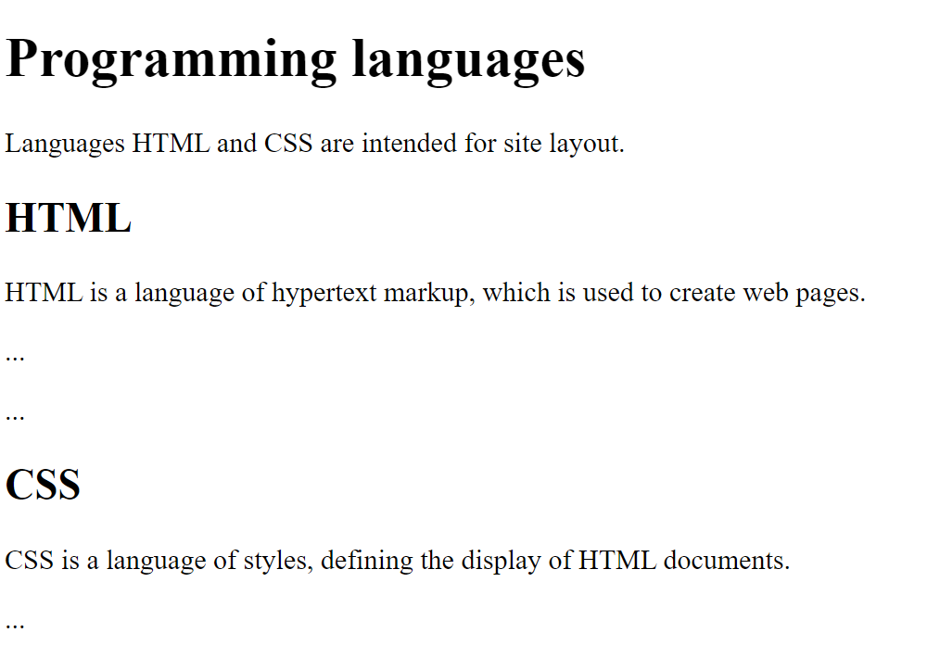

Slide 48
The <figure> element
The <figure> element is used for indicating self-contained content. The tag can include images, diagrams, illustrations, code examples, etc.

Slide 49
<!DOCTYPE html>
<html>
<head>
<title>Title of the document</title>
</head>
<body>
<p>A cute baby</p>
<figure>
<img src="/uploads/media/default/0001/01/25acddb3da54207bc6beb5838f65f022feaa81d7.jpeg" alt="A Cute Baby" width="250" height="200">
</figure>
</body>
</html>

Slide 50
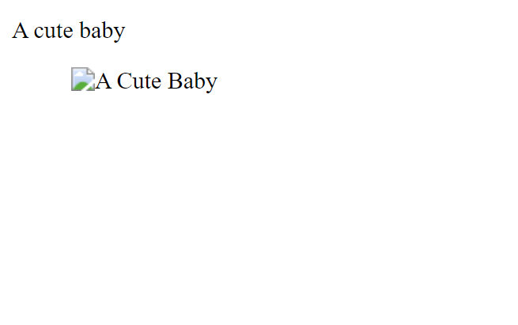

Slide 51
The <figcaption> element
The <figcaption> element is used for adding signature or annotation to the <figure> tag.

Slide 52
<!DOCTYPE html>
<html>
<head>
<title>Title of the document</title>
</head>
<body>
<p>Image of a baby</p>
<figure>
<img src="/uploads/media/default/0001/01/25acddb3da54207bc6beb5838f65f022feaa81d7.jpeg" alt="A Cute Baby" width="250" height="200">
<figcaption>Fig.1 – Cute baby</figcaption>
</figure>
</body>
</html>

Slide 53
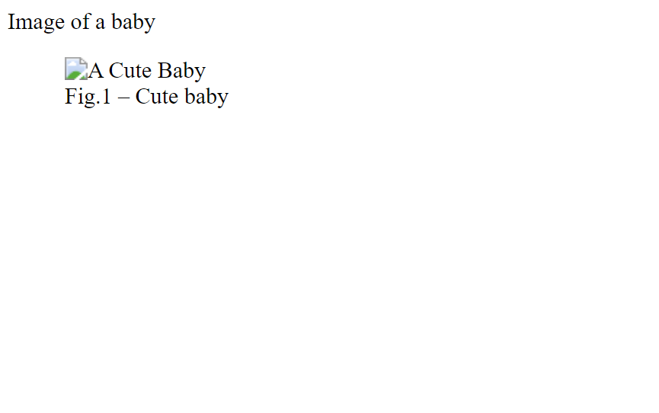

Slide 54
The <time> element
The <time> element defines a human-readable time on a 24-hour clock or a precise date in the Gregorian calendar.

Slide 55
<!DOCTYPE html>
<html>
<head>
<title>Title of the document.</title>
</head>
<body>
<p>Exam time will be<time datetime="2022-12-28 21:00">September 28</time>.</p>
<p>It will start at <time>19:00</time></p>
</body>
</html>

Slide 56
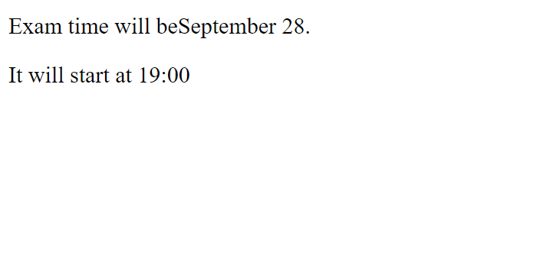

Slide 57
The <mark> element
The <mark> element is used to mark a part of the text which has relevance. It can be used to highlight a text for showing emphasis, highlight search terms in search results to provide context, or distinguish a new content added by the user by showing it differently.

Slide 58
<!DOCTYPE html>
<html>
<head>
<title>Title of the document</title>
</head>
<body>
<p>Learn HyperText markup language (HTML) on <mark>abcd.com</mark> website.</p>
</body>
</html>

Slide 59
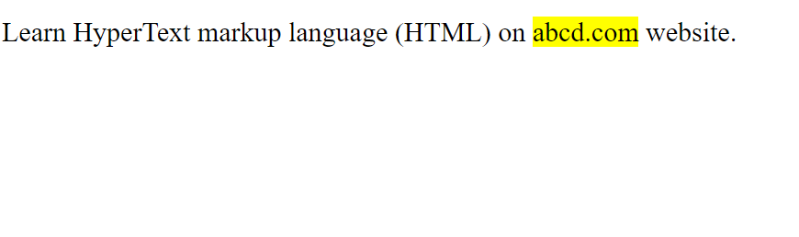

Slide 60
The <bdi> element
The <bdi> element is used to isolate bidirectional text when a language with a right-to-left directionality, such as Arabic or Hebrew, is used inline with left-to-right languages.

Slide 61
<!DOCTYPE html>
<html>
<head>
<title>Title of the documnet</title>
</head>
<body>
<h1> Example of using the bdi element </h1>
<p dir="ltr"><bdi>أرمينيا جميلة</bdi> This sentence in Arabic is automatically displayed from right to left.</p>
</body>
</html>

Slide 62
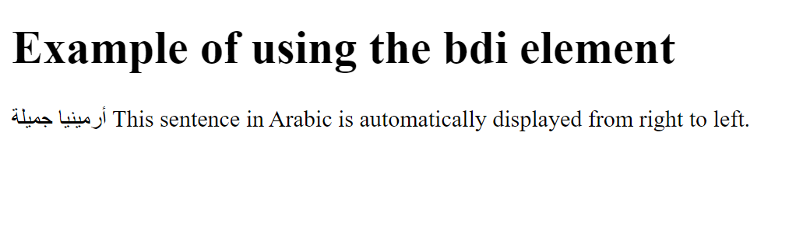

Slide 63
The <wbr> element
The <wbr> tag is used to instruct the browser, where a line-break could be added in the text. Unlike the <br> tag, which obliges the browser to insert a line-break, in the case of <wbr> the browser first analyzes its content, and then inserts a line-break if necessary (too long word or URL address).

Slide 64
<!DOCTYPE html>
<html>
<head>
<title>Title of the document</title>
</head>
<body>
<p>Example of a long string of text without wbr.</p>
<p>This is the longest word you can ever meet in the English </p>
<p>Example of a long string of text with wbr.</p>
<p>This is the longest word you can ever meet in the English language pneumono<wbr>ultra<wbr>micro<wbr>scopic<wbr>silico<wbr>volcano<wbr>coniosis</p>
</p>
</body>
</html>

Slide 65
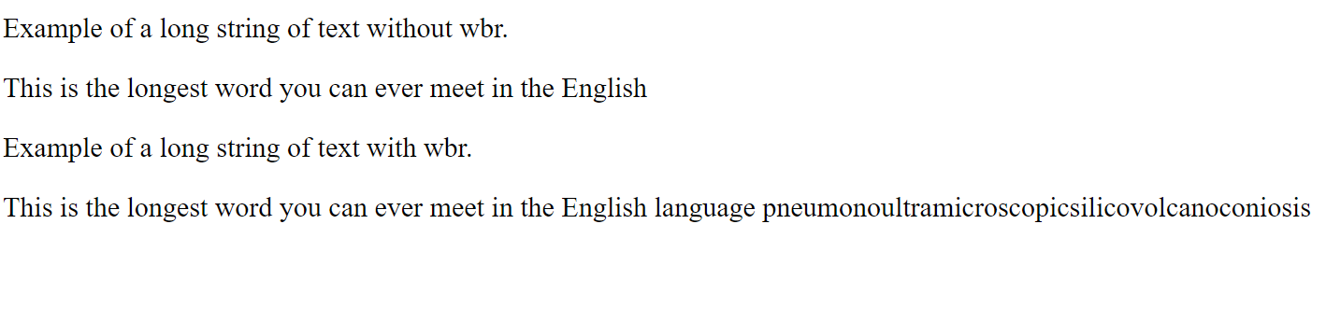

Slide 66
New Input Types in HTML5
HTML5 introduces several new <input> types like email, date, time, color, range, and so on. to improve the user experience and to make the forms more interactive. However, if a browser failed to recognize these new input types, it will treat them like a normal text box

Slide 67
Input Type Color
The color input type allows the user to select a color from a color picker and returns the color value in hexadecimal format (#rrggbb). If you don't specify a value, the default is #000000, which is black.
Let's try out the following example to understand how it basically works:
ExampleTry this code »
<form>
<label for="mycolor">Select Color:</label>
<input type="color" value="#00ff00" id="mycolor">
</form>

Slide 68
Input Type Date
The date input type allows the user to select a date from a drop-down calendar.
The date value includes the year, month, and day, but not the time.
ExampleTry this code »
<form>
<label for="mydate">Select Date:</label>
<input type="date" value="2019-04-15" id="mydate">
</form>

Slide 69
Input Type Datetime-local
The datetime-local input type allows the user to select both local date and time, including the year, month, and day as well as the time in hours and minutes.
Let's try out the following example to understand how it basically works:
ExampleTry this code »
<form>
<label for="mydatetime">Choose Date and Time:</label>
<input type="datetime-local" id="mydatetime">
</form>

Slide 70
Input Type Email
The email input type allows the user to enter e-mail address. It is very similar to a standard text input type, but if it is used in combination with the required attribute, the browser may look for the patterns to ensure a properly-formatted e-mail address should be entered.
Let's try out this example by entering any e-mail address to see how it actually works:
ExampleTry this code »
<form>
<label for="myemail">Enter Email Address:</label>
<input type="email" id="myemail" required>
</form>

Slide 71
Input Type Month
The month input type allows the user to select a month and year from a drop-down calendar.
The value is a string in the format "YYYY-MM", where YYYY is the four-digit year and MM is the month number. Let's try out an example to see how this basically works:
ExampleTry this code »
<form>
<label for="mymonth">Select Month:</label>
<input type="month" id="mymonth">
</form>

Slide 72
Input Type Number
The number input type can be used for entering a numerical value. You can also restrict the user to enter only acceptable values using the additional attributes min, max, and step.
The following example will allow you to enter a numeric value between 1 to 10.
ExampleTry this code »
<form>
<label for="mynumber">Enter a Number:</label>
<input type="number" min="1" max="10" step="0.5" id="mynumber">
</form>

Slide 73
Input Type Range
The range input type can be used for entering a numerical value within a specified range. It works very similar to number input, but it offers a simpler control for entering a number.
Let's try out the following example to understand how it basically works:
ExampleTry this code »
<form>
<label for="mynumber">Select a Number:</label>
<input type="range" min="1" max="10" step="0.5" id="mynumber">
</form>

Slide 74
Input Type Search
The search input type can be used for creating search input fields.
A search field typically behaves like a regular text field, but in some browsers like Chrome and Safari as soon as you start typing in the search box a small cross appears on the right side of the field that lets you quickly clear the search field. Let's try out an example to see how it works:
ExampleTry this code »
<form>
<label for="mysearch">Search Website:</label>
<input type="search" id="mysearch">
</form>

Slide 75
Input Type Time
The time input type can be used for entering a time (hours and minutes).
Browser may use 12- or 24-hour format for inputting times, based on local system's time setting.
ExampleTry this code »
<form>
<label for="mytime">Select Time:</label>
<input type="time" id="mytime">
</form>

Slide 76
Input Type URL
The url input type can be used for entering URL's or web addresses.
You can use the multiple attribute to enter more than one URL. Also, if required attribute is specified browser will automatically carry out validation to ensure that only text that matches the standard format for URLs is entered into the input box. Let's see how this works:
ExampleTry this code »
<form>
<label for="myurl">Enter Website URL:</label>
<input type="url" id="myurl" required>
</form>

Slide 77
Input Type Week
The week input type allows the user to select a week and year from a drop-down calendar.
Let's try out the following example to understand how this works:
ExampleTry this code »
<form>
<label for="myweek">Select Week:</label>
<input type="week" id="myweek">
</form>

Slide 78
HTML-5 Audio Element
The newly introduced HTML5 <audio> element provides a standard way to embed audio in web pages. However, the audio element is relatively new but it works in most of the modern web browsers.
The following example simply inserts an audio into the HTML5 document, using the browser default set of controls, with one source defined by the src attribute.

Slide 79
<!DOCTYPE html>
<html lang="en">
<head>
<meta charset="utf-8">
<title>Embedding Audio into an HTML Page</title>
</head>
<body>
<audio controls="controls" src="/examples/audio/birds.mp3">
Your browser does not support the HTML5 audio element.
</audio>
</body>
</html>

Slide 80
<!DOCTYPE html>
<html lang="en">
<head>
<meta charset="utf-8">
<title>Specify Alternate Sources for audio Element in HTML</title>
</head>
<body>
<audio controls="controls">
<source src="/examples/audio/birds.mp3" type="audio/mpeg">
<source src="/examples/audio/birds.ogg" type="audio/ogg">
Your browser does not support the HTML5 audio element.
</audio>
</body>
</html>

Slide 81
Linking audio
<!DOCTYPE html>
<html lang="en">
<head>
<meta charset="utf-8">
<title>Linking Audio Files in HTML</title>
</head>
<body>
<p><a href="/examples/audio/sea.mp3">Track 1</a></p>
<p><a href="/examples/audio/wind.mp3">Track 2</a></p>
</body>
</html>

Slide 82
<!DOCTYPE html>
<html lang="en">
<head>
<meta charset="utf-8">
<title>Inserting Audio Using embed Element</title>
</head>
<body>
<embed src="/examples/audio/wind.mp3">
<embed src="/examples/audio/wind.ogg">
</body>
</html>

Slide 83
HTML-5 Video Element
The newly introduced HTML5 <video> element provides a standard way to embed video in web pages.
the video element is relatively new, but it works in most of the modern web browsers.
The following example simply inserts a video into the HTML document, using the browser default set of controls, with one source defined by the src attribute.

Slide 84
<!DOCTYPE html>
<html lang="en">
<head>
<meta charset="utf-8">
<title>Embedding Video into an HTML Page</title>
</head>
<body>
<video controls="controls" src="/examples/video/shuttle.mp4">
Your browser does not support the HTML5 Video element.
</video>
</body>
</html>

Slide 85
<!DOCTYPE html>
<html lang="en">
<head>
<meta charset="utf-8">
<title>Specify Alternate Sources for video Element in HTML</title>
</head>
<body>
<video controls="controls">
<source src="/examples/video/shuttle.mp4" type="video/mp4">
<source src="/examples/video/shuttle.ogv" type="video/ogg">
Your browser does not support the HTML5 Video element.
</video>
</body>
</html>

